Slide 1
Introduction
Linear Circuit Analysis
EECE 202

Slide 2
Number of credits: 3 credits
Prerequisites: EECE 201
Contact Hours: 3 hrs Lecture
Textbook/material required: R. A. DeCarlo and P-M. Lin, “Linear Circuit Analysis; The Time Domain, Phasor and Laplace Transform Approach”, 3rd Edition, 2009.

Slide 3
Learning Outcomes
By the end of this course, the student should be able to:
An ability to compute impedances and admittances of components and circuits. SO[1]
An ability to compute responses of linear circuits with and without initial conditions via one-sided Laplace transform techniques. SO[1]
An ability to compute responses to linear circuits using transfer function and convolution techniques. SO[1]
An ability to analyze and compute responses of linear circuits containing mutually coupled inductors and ideal transformers in the s-domain. SO[1]
An ability to analyze basic two port circuits using the various types of two port parameters and be able to construct such parameters from a given circuit. SO[1]
An ability to analyze and design basic LP, BP, HP and resonant circuits in the s-domain. SO[1]
an ability to work within a team, develop hands-on experience, draw conclusion and communicate results through the offered course project. SO[2,3,5]

Slide 4
 | Assessment |  | Weight
Attendance |  |  | 5%
Assignments | PD1 – Conceptual Design Presentation (Week 10) |  | 3 x 10%
 | PD2 – Technical Report (10%) (Week 12) | PD2 – Prototype Demonstration
 | PD3 – Prototype Demonstration (10%) (Week 14)
Graded Class Activity (GCA) | GCA – 1 (Week 6, L2) |  | 2 x 10%
 | GCA – 2 (Week 11, L2)
Moodle Quiz | Quiz (Week 4) |  | 5%
Midterm | Week 8 |  | 20%
Final exam | Week 16 |  | 20%
 |  | Total | 100%

Slide 5
Revision on EE201

Slide 6
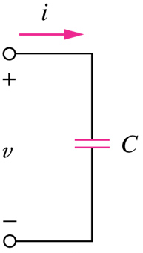
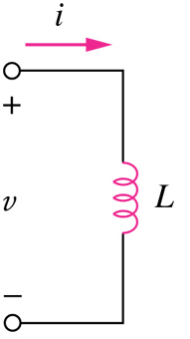
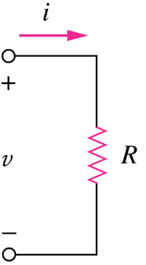
Passive Elements
Resistor
Inductor
Capacitor

Slide 7
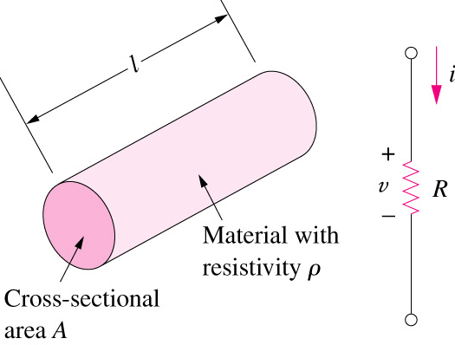
Ohm’s Law
Ohm’s law states that the voltage “V” across a resistor “R” is directly proportional to the current “I” flowing through the resistor
V = I×R

Slide 8
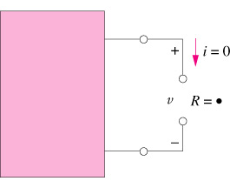
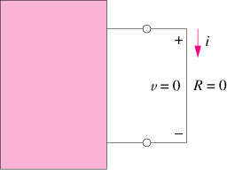
As R varies from zero to infinity, it is necessary to study the relation between V and I at the extreme values of R
Short Circuit Case
R = zero, V = zero
Open Circuit Case
R = ∞, I = zero

Slide 9
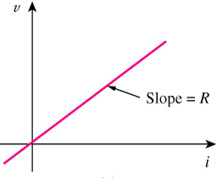
V-I characteristics according to Ohm’s law
V = I×R
I = V/R
R = V/I

Slide 10
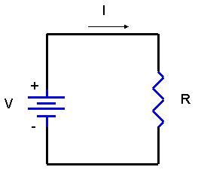
Power calculations according to Ohm’s Law
V = I × R
P = V × I
P = I²× R
P = V²/ R

Slide 11
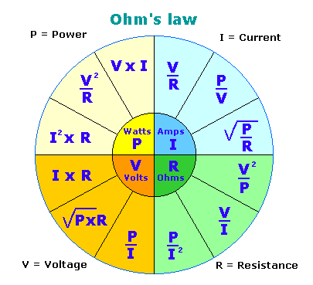

Slide 12
Example 7
A resistor formed of a copper conductor of length 0.1 m and cross-sectional area 4×10⁻⁴ m², the resistivity of copper is 1.72×10⁻⁸ Ω.m find the current flowing through the resistor when a 10 V battery is connected across its terminals.
Solution
Since I = V/R
And R = δL/A = 1.72×10⁻⁸ ×0.1/4×10⁻⁴ = 43×10⁻⁷ Ω
Then I = 10/43×10⁻⁷ = 2.3 MA

Slide 13
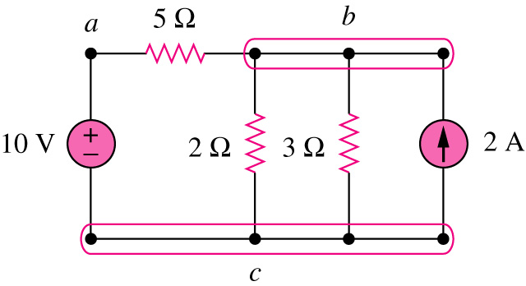
Nodes, Branches and Loops
Branch: represents a single element such as a voltage source or a resistor
A branch represents any element with two terminals
(Vb-10)/5 - (Vb/2) - (Vb/3) – 2 = 0
There are five branches in the shown figure, namely the 10 V voltage source, the 2-A current source and the three resistors.

Slide 14
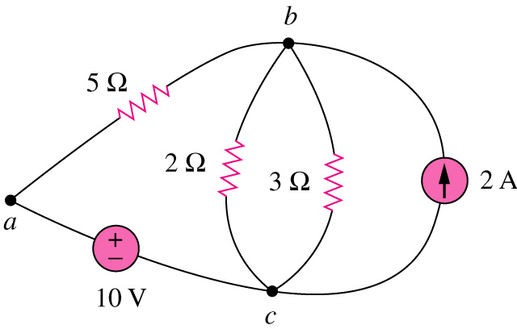
Nodes, Branches and Loops
Node: is the point of connection between two or more branches
There are three nodes in the shown circuit, a, b and c
A node is usually indicated by a dot in a circuit, but if a short circuit connects two nodes, the two nodes constitute a single node

Slide 15
Nodes, Branches and Loops
Loop: is a closed path formed by starting at a node, passing through a set of nodes and returning to the starting node without passing through any node more than once
abca is a loop, where the flow from b to c could be done via: the 2 ohm resistor, the 3 ohm resistor, …………………etc

Slide 16
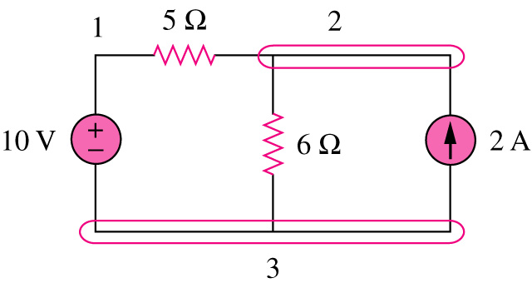
Example(8)
Determine the number of branches and nodes in the shown circuit
Solution
As the circuit has four elements, then there are four branches as follows:
the 10 V voltage source
the 2A current source
the 5 ohm resistor
the 6 ohm resistor
There are three nodes in the circuit 1, 2 and 3
(V2-10/5) + (V2/6) – 2 = 0

Slide 17
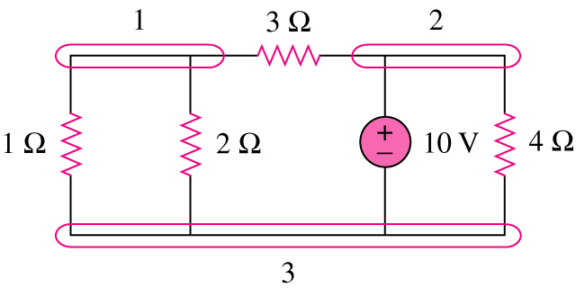
Example(9)
Determine the number of branches and nodes in the shown circuit
Solution
As the circuit has five elements, then there are five branches as follows:
the 10 V voltage source
the 1ohm resistor
the 2 ohm resistor
the 3 ohm resistor
the 4 ohm resistor
There are three nodes in the circuit 1, 2 and 3

Slide 18
Resistor’s Arrangements
There are three possible arrangements for resistors in an electrical circuit
Series
&
Parallel
Series
Parallel

Slide 19
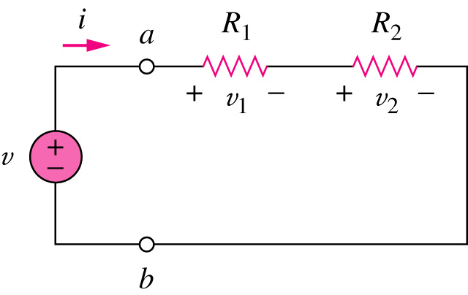
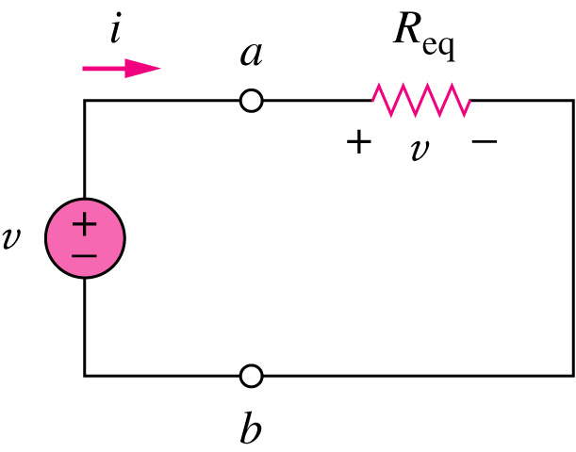
Resistors in Series
Two or more elements are said to be in series if they exclusively share a single node and consequently carry the same current
V = V₁ + V₂ = I R₁ + I R₂= I (R₁ + R₂)
V = I R_{eq}
For N resistors placed in series
R_{eq} = R₁ + R₂ +……………….R_{N}

Slide 20
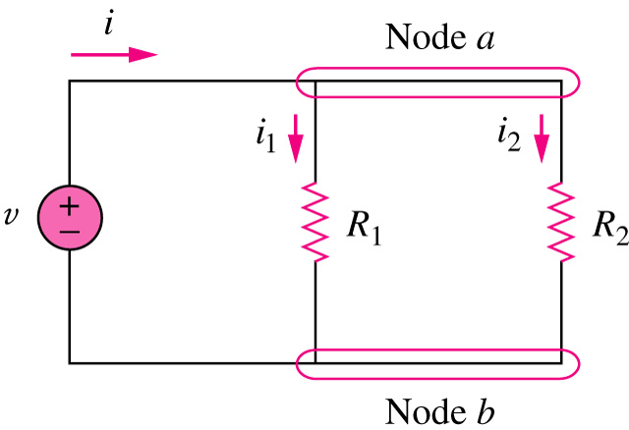
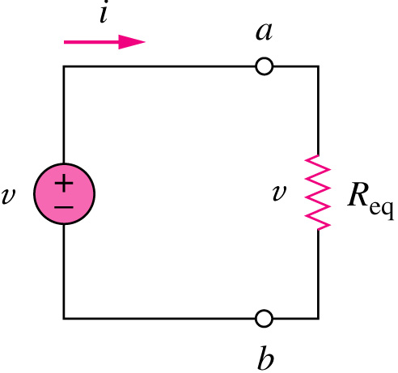
Resistors in Parallel
Two or more elements are said to be in parallel if they are connected to the same two nodes and consequently have the same voltage across them
V = I₁R₁ = I₂R₂
But since I = I₁ + I₂ , then
I = (V/R₁ + V/R₂) = V (R₁+R₂)/R₁R₂
and as, R_{eq} = V/I…then
R_{eq} = R₁R₂/(R₁+R₂)
For N resistors placed in parallel
1/R_{eq} = 1/R₁ + 1/R₂ +……………1/R_{N}

Slide 21
Conductance “G”
The conductance is a measure of how well an element will conduct electric current
The unit of conductance is “Siemens” and with the symbol of “S”
G = 1/R = I/V (S)
Note: the equivalent of N parallel resistors could be calculated using conductance, where:
G_{eq} = G₁ + G₂ +…………………..G_{N}

Slide 22
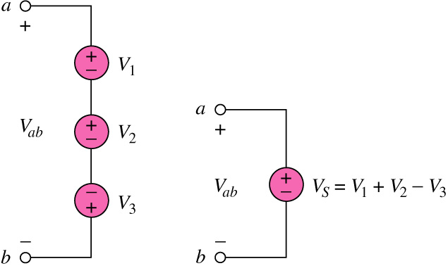
Voltage sources placed in Series
Note the voltage source sign when obtaining their equivalence

Slide 23
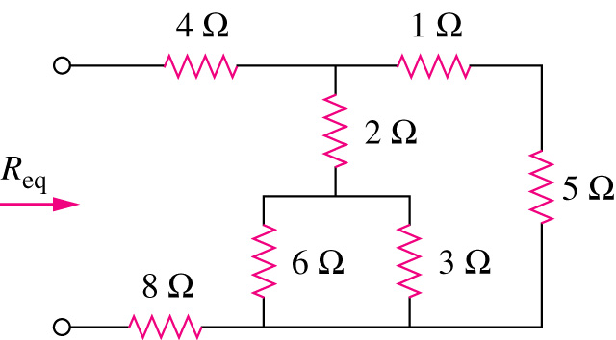
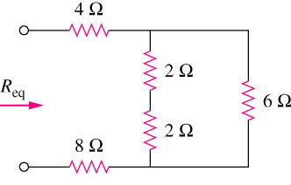
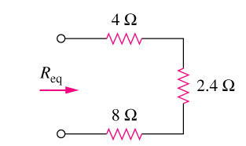
Example(10)
Find R_{eq} for the shown resistor arrangement
Solution
R_{eq} = 4 + 8 + 2.4 = 14.4 Ω

Slide 24
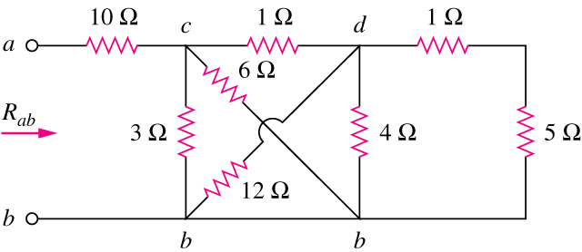
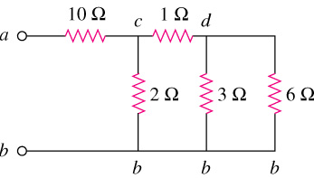
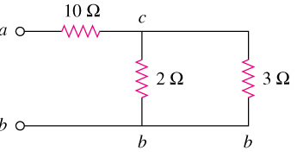
Example(11)
Find R_{eq} for the shown resistor arrangement
Solution
R_{eq} = 10 + (3×2)/(3+2) = 11.2 Ω

Slide 25
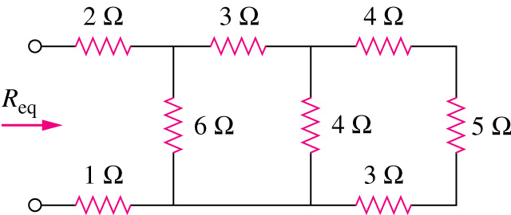
Example(12)
Find R_{eq} for the shown resistor arrangement
Solution
Try to solve
Final answer 6 Ω

Slide 26
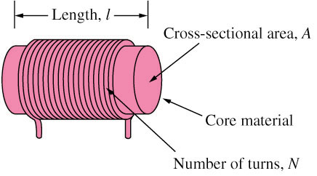
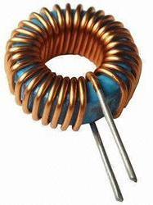
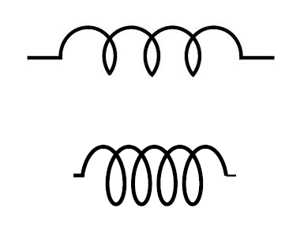
Inductors
An inductor is a two terminal passive element designed to store energy in its magnetic field.
L
i_{L} (t)
+ V_{L} (t) –
Follow passive sign
convention
An inductor consists of a coil of conducting wire.
Inductors store electromagnetic energy.
They may supply stored energy back to the circuit, but they cannot create energy.
They must abide by the passive sign convention
31-Jan-24 Dr. Gaouda

Slide 27
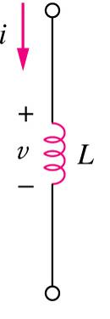
Current voltage relationship of an inductor
The inductor voltage is proportional to the derivative of the current passing through it.
i_{L} (t)
L
+ V_{L} (t) –
Where L is the inductance of the inductor and its unit is Henry (H).
An inductor acts like a short circuit in a DC circuit since di/dt = 0.
The inductor current cannot change abruptly.

Slide 28
Example 7.1 (page 274)
Find the voltage across the Inductor.

Slide 29
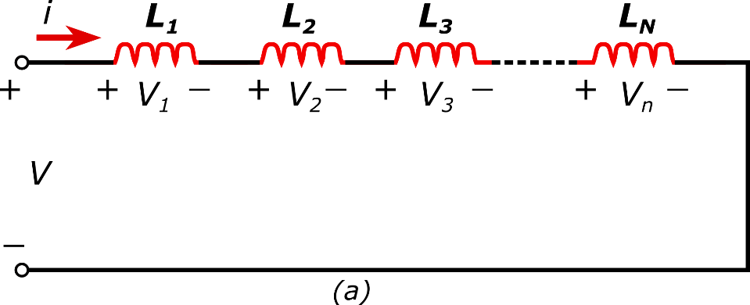
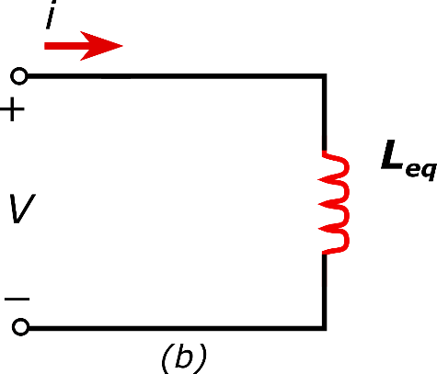
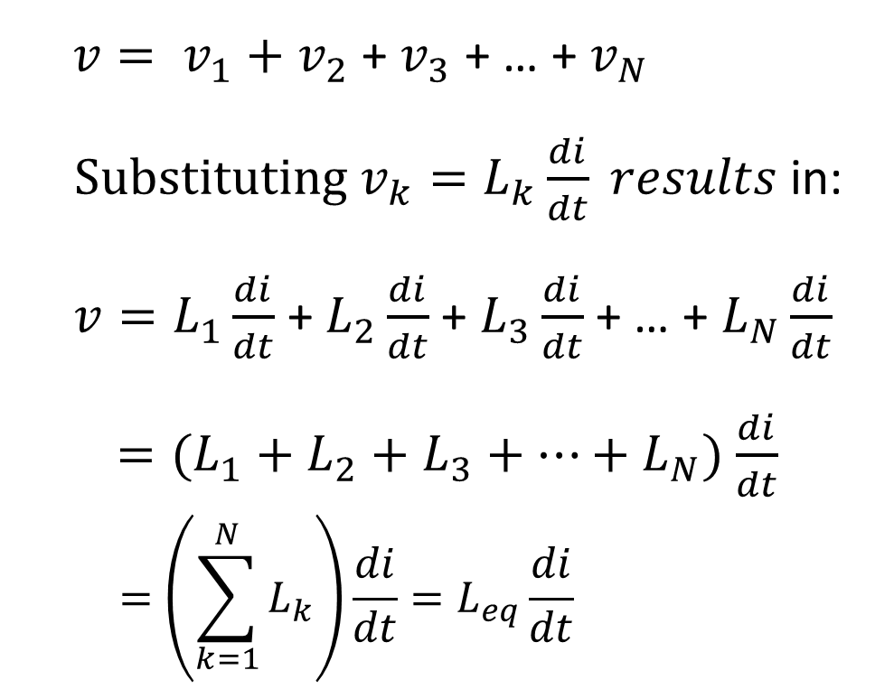
Series and parallel inductors
The equivalent inductance of series-connected inductors is the sum of the individual inductances.
$v= v_{1}+$ $v_{2}$ +${ v}_{3}$ + … +$v_{N}$
$Substituting v_{k}=L_{k}\frac{di}{dt} results$ in:
$v=L_{1}\frac{di}{dt}$ + $L_{2}\frac{di}{dt}$ + $L_{3}\frac{di}{dt}$ + … + $L_{N}\frac{di}{dt}$
$=(L_{1}+L_{2}+L_{3}+…+L_{N})$ $\frac{di}{dt}$
$$=\left(\sum_{k=1}^{N}{L_{k}}\right)\frac{di}{dt}=L_{eq}\frac{di}{dt}$$

Slide 30
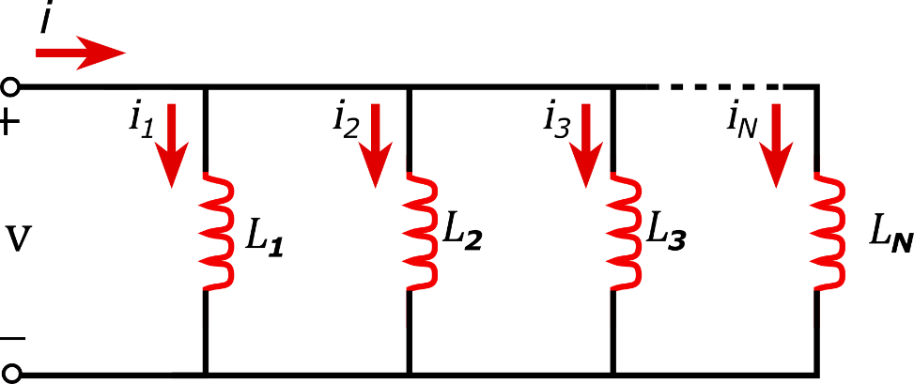
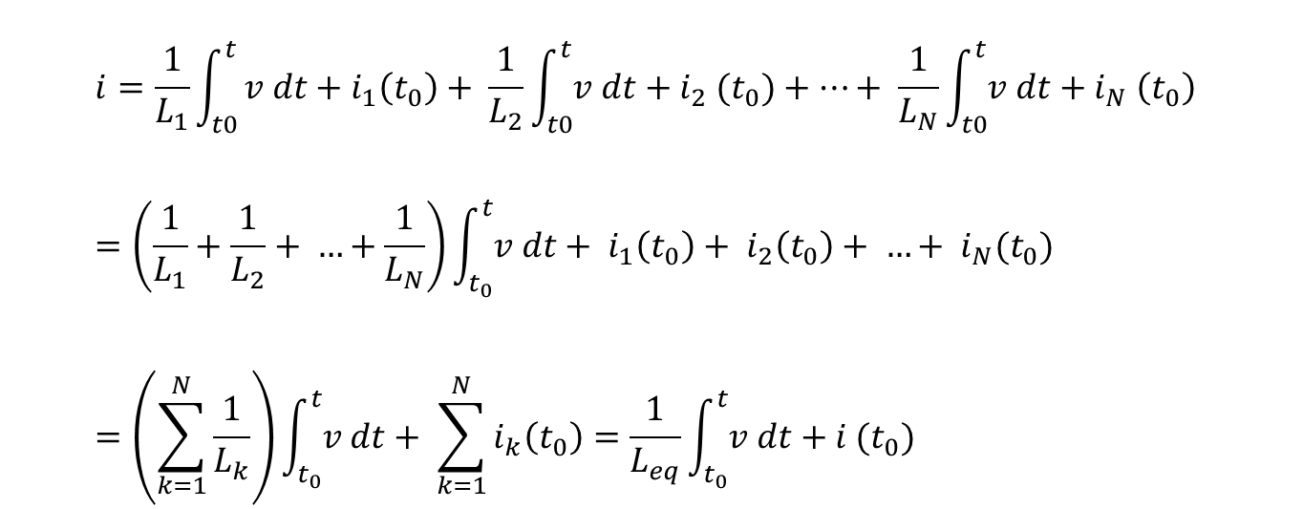
Series and parallel inductors
The equivalent inductance of parallel inductors is the reciprocal of the sum of the reciprocals of the individual inductances.
$$i=\frac{1}{L_{1}}\int_{t0}^{t}{v dt+i_{1}\left(t_{0}\right)+ \frac{1}{L_{2}}}\int_{t0}^{t}{v dt+i_{2} (t_{0})}+…+ \frac{1}{L_{N}}\int_{t0}^{t}{v dt+i_{N} \left(t_{0}\right)} =\left(\frac{1}{L_{1}}+\frac{1}{L_{2}}+ …+\frac{1}{L_{N}}\right)\int_{t_{0}}^{t}{v dt+ i_{1}\left(t_{0}\right)+ i_{2}\left(t_{0}\right)+ …+ i_{N}(t_{0})}=\left(\sum_{k=1}^{N}{\frac{1}{L_{k}}}\right)\int_{t_{0}}^{t}{v dt}+ \sum_{k=1}^{N}{i_{k}\left(t_{0}\right)}=\frac{1}{L_{eq}}\int_{t_{0}}^{t}{v dt}+i (t_{0})$$
(a)

Slide 31
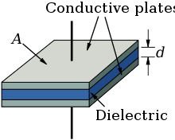
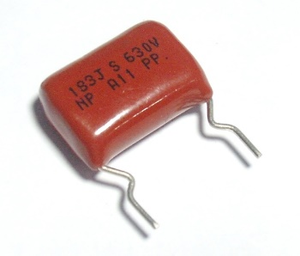
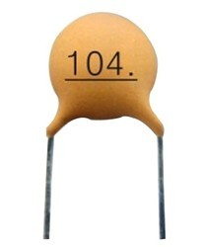
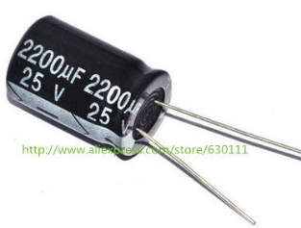
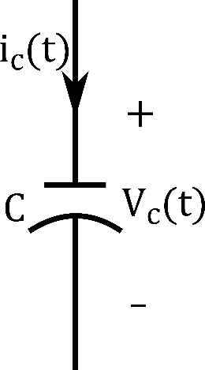
Capacitors
A capacitor is a passive element designed to store energy in its electric field. It consists of two conducting plates separated by an insulator (or dielectric).
Fixed capacitors
Polyester capacitor
Ceramic capacitor
Electrolytic capacitor
Capacitance of a capacitor is the ratio of the charge on one plate to the voltage difference between the two plates, measured in farads (F).
NOTE: 1 farad = 1 coulomb/volt.

Slide 32
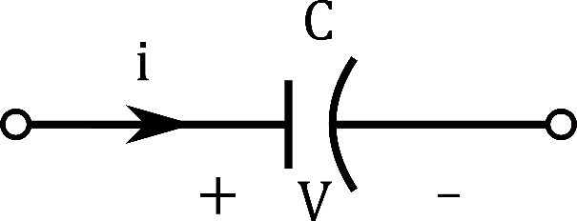
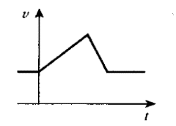
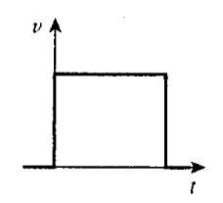
The current-voltage relationship of a capacitor
The charge, voltage and capacitance can be mathematically presented as:
The current in the capacitors is:
where C is the capacitance of the capacitor measured in farad (F)
NOTE
If a DC voltage is applied, the capacitor will be an open circuit.
The capacitor voltage cannot change abruptly.
allowable voltage change
Not allowable voltage change

Slide 33
Example
Find the voltage across a capacitor of 2 micro Farads holding 100 micro Coulomb of charge.
Example
Determine the voltage across a 2 μF capacitor if the current passing through it is: i(t) = 6e^{−3000t} mA. Assume v(0) =0.

Slide 34
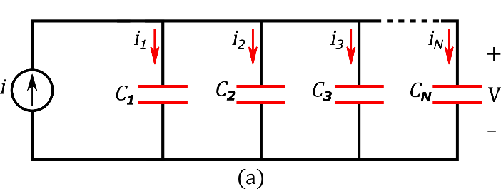
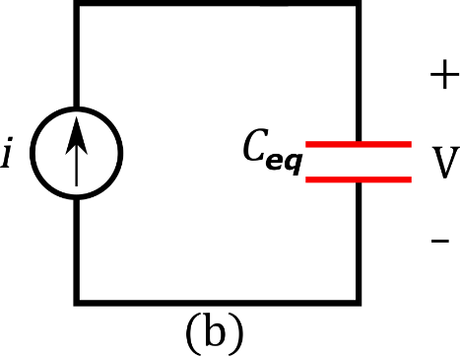
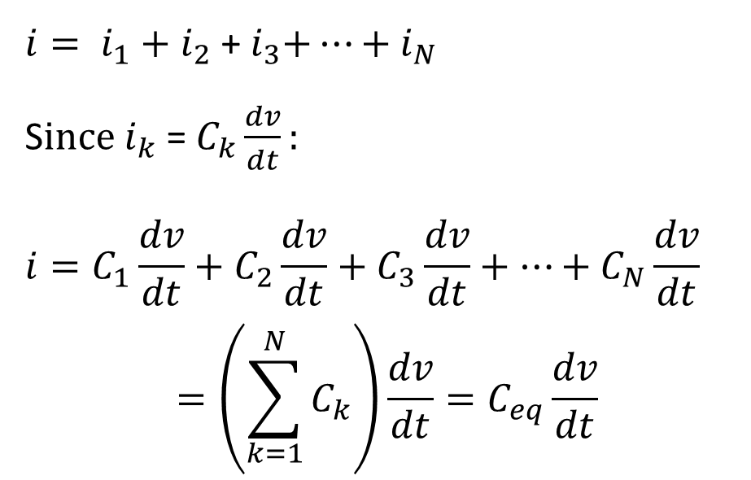
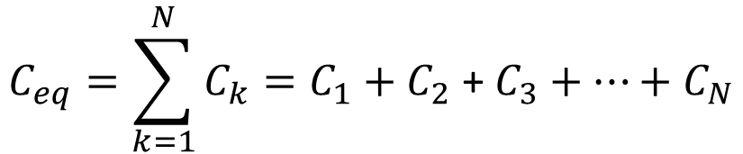
Series and parallel capacitors
The equivalent capacitance of N parallel-connected capacitors is the sum of the individual capacitances.
$i= i_{1}+i_{2}$ +${ i}_{3}+…+i_{N}$
S$ince i_{k}$ = $C_{k}\frac{dv}{dt}:$
$$i=C_{1}\frac{dv}{dt}+C_{2}\frac{dv}{dt}+C_{3}\frac{dv}{dt}+…+C_{N}\frac{dv}{dt}$$
$$=\left(\sum_{k=1}^{N}{C_{k}}\right)\frac{dv}{dt}=C_{eq}\frac{dv}{dt}$$
$$C_{eq}=\sum_{k=1}^{N}{C_{k}=C_{1}+C_{2}\text{ +}{ C}_{3}+…+C_{N}}$$

Slide 35
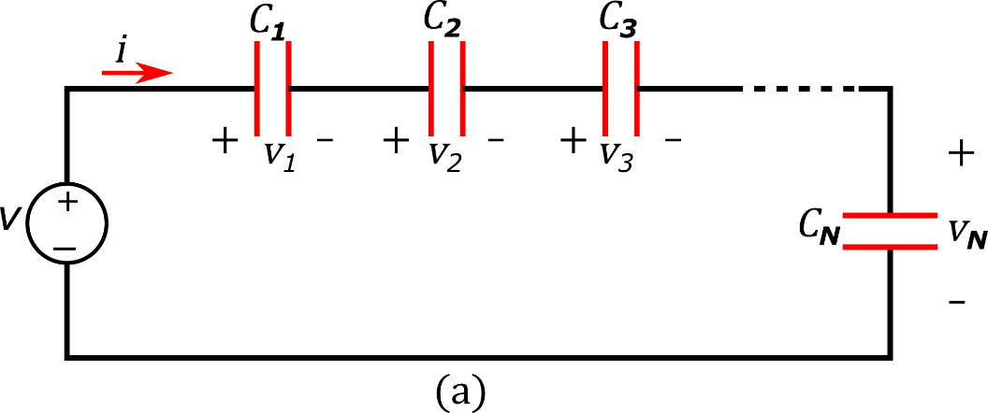
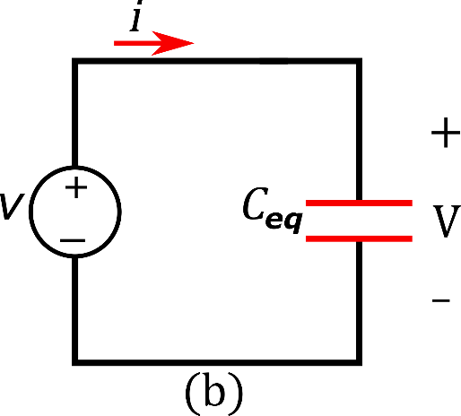
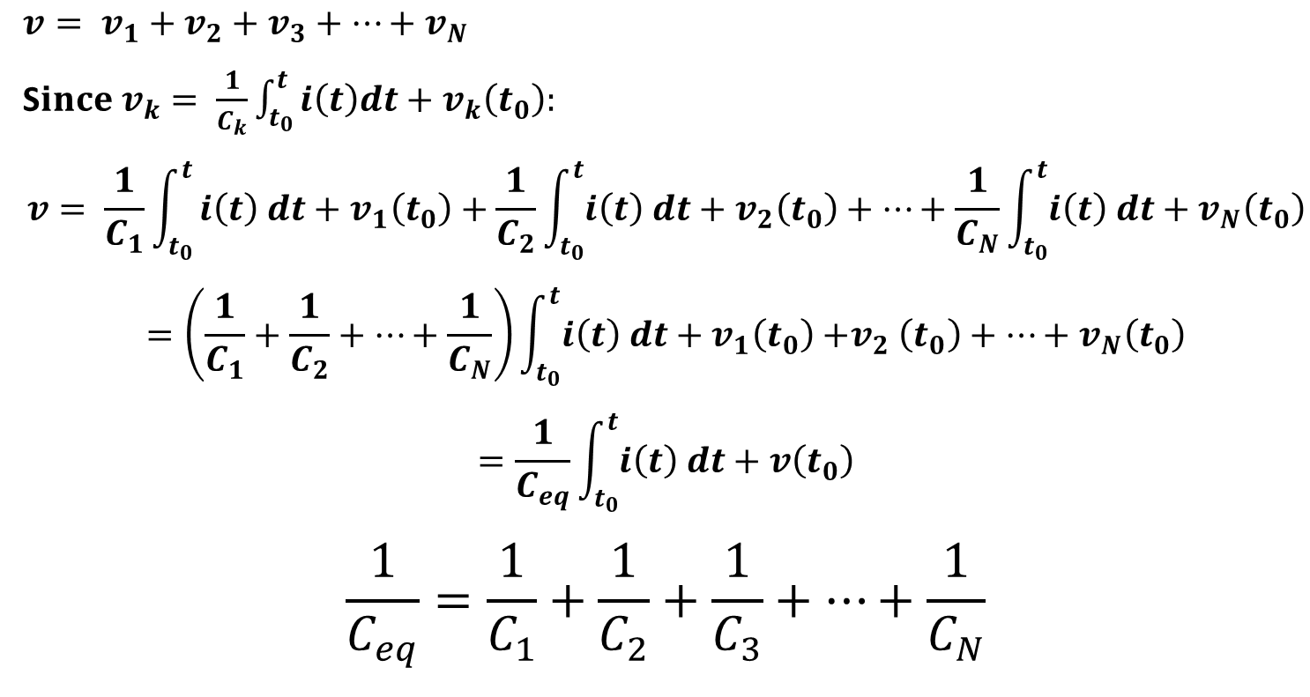
Series and parallel capacitors
The equivalent capacitance of N series-connected capacitors is the inverse of the sum of the inverses of the individual capacitances.
$$v= v_{1}+v_{2}+v_{3}+…+v_{N}$$
S$ince v_{k}= \frac{1}{C_{k}}\int_{t_{0}}^{t}{i\left(t\right)dt+v_{k}\left(t_{0}\right):}$
$$v= \frac{1}{C_{1}}\int_{t_{0}}^{t}{i\left(t\right) dt+v_{1}\left(t_{0}\right)+\frac{1}{C_{2}}\int_{t_{0}}^{t}{i\left(t\right) dt+v_{2}\left(t_{0}\right)}+…+\frac{1}{C_{N}}\int_{t_{0}}^{t}{i\left(t\right) dt+v_{N}\left(t_{0}\right)}}$$
$$=\left(\frac{1}{C_{1}}+\frac{1}{C_{2}}+…+\frac{1}{C_{N}}\right)\int_{t_{0}}^{t}{i\left(t\right) dt+v_{1}\left(t_{0}\right){+v}_{2}\left(t_{0}\right)+…+v_{N}\left(t_{0}\right)}$$
$$=\frac{1}{C_{eq}}\int_{t_{0}}^{t}{i\left(t\right) dt+v\left(t_{0}\right)}$$
$$\frac{1}{C_{eq}}=\frac{1}{C_{1}}+\frac{1}{C_{2}}+\frac{1}{C_{3}}+…+\frac{1}{C_{N}}$$

Slide 36
Example
Find the equivalent capacitance seen between terminals a and b
C2
C1
C2=(20*5/25)+6=10 μF
C1=C2+10=30 μF

